Slide 1
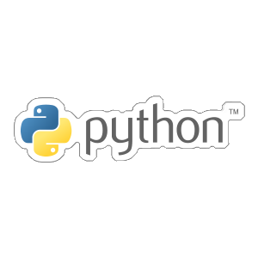

Lawrence Okegbemi
bitgrit Campus Ambassador
email: lawrencebolu@gmail.com
@Lawrence_Bolu

Slide 2
What we will cover in this slide include:
PART I
Functions
Comments and DocStrings
PART 2
Object Oriented Programming (OOP)
Lawrence Okegbemi (bitgrit Campus Ambassador)

Slide 3
What is a Function?
A Function is a block of organized and reusable code that runs only when it is called and also perform a particular action.
Function provides extensible abilities especially when certain codes needs to be reuse.
Lawrence Okegbemi (bitgrit Campus Ambassador)

Slide 4
Types of Functions?
In python, we can divide functions into 2 types:
Built-in Functions
User-defined Functions
Lawrence Okegbemi (bitgrit Campus Ambassador)

Slide 5
Built-in Functions
These type of functions are predefined functions that are readily available to use. Python has numerous built-in functions including:
print()
str()
abs()
bin()
etc.
Lawrence Okegbemi (bitgrit Campus Ambassador)

Slide 6
User-defined Functions
Python also gives us the flexibility to create our own functions. We can start creating our own function by using the keyword def you can use the construct below.
def name_of_func(parameters):
“”” doctstring ”””
Block_of_Code
return value
Lawrence Okegbemi (bitgrit Campus Ambassador)

Slide 7
Basic Rules Functions
Here are some basic rules associated with functions:
The keyword def is use to start a function
A function name which follows the rules associated with defining identifiers in python
Parameters(Arguments) in parentheses(), through which we pass values into a function. Arguments are optional
Lawrence Okegbemi (bitgrit Campus Ambassador)

Slide 8
Basic Rules Functions
A colon(:) is added which indicate the end of the function header and beginning of the block of code
We can also create an optional documentation string (docstring) to describe what the function does
One or more valid python statements that consist of the function body. Statements must have same indentation level (usually 4 spaces)
An optional return statement to return a value from the function
Lawrence Okegbemi (bitgrit Campus Ambassador)

Slide 9
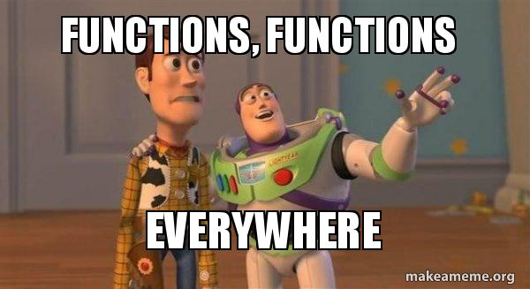
Lawrence Okegbemi (bitgrit Campus Ambassador)

Slide 10
Arguments/Parameters
From a function's perspective:
A parameter is the variable listed inside the parentheses in the function definition.
An argument is the value that are sent to the function when it is called.
Lawrence Okegbemi (bitgrit Campus Ambassador)

Slide 11
Arguments
You can pass in many arguments as you want into a function, just separate them with a comma(,)
Tip: Arguments are often shotten as args in python docs.
When calling functions, the correct number of arguments which was passed when creating the function must be called.
Lawrence Okegbemi (bitgrit Campus Ambassador)

Slide 12
Arbitrary Arguments, *args
If the number of Arguments is yet to be determined, then we will use one asterics (*) in front the parameter name in the function definition:
def my_function(*fruits):
print("My best fruit is " + fruits[3])
my_function("Apple", "Banana", "Mango")
Lawrence Okegbemi (bitgrit Campus Ambassador)

Slide 13
Keyword Arguments
A keyword argument accepts
key = value Syntax, in this case the order of arrangement of the arguments does not matter.
def shape_col(shape1, shape2, shape3):
print("The youngest child is " + shape2)
shape_col(shape1 = "Rec", shape2 = "Square", shape3 = "circle")
Lawrence Okegbemi (bitgrit Campus Ambassador)

Slide 14
Arbitrary keyword
Arguments, **kwargs
If the number of keyword Arguments is yet to be determined, then we will use one asterics (**) in front the parameter name in the function definition:
Lawrence Okegbemi (bitgrit Campus Ambassador)

Slide 15
Return Values
The statement return [Expression] exits a function, and can optionally pass an expression back to the caller.
Lawrence Okegbemi (bitgrit Campus Ambassador)

Slide 16
Pass Statement
If a function is defined without any content, the pass statement is use to avoid error.
def myfunction():
pass
Lawrence Okegbemi (bitgrit Campus Ambassador)

Slide 17
Comments and Doctstrings
Lawrence Okegbemi (bitgrit Campus Ambassador)

Slide 18
Comments
In most programming language, comments are statements that doesn’t get executed by the compiler. They are just there to describe a what a particular code does.
Comments in python are preceded by
a hash(#) symbol.
# This line is a comment
Lawrence Okegbemi (bitgrit Campus Ambassador)

Slide 19
Docstrings
What is a Docstring?
A docstring is a string literal that occurs as the first statement in a module, function, class, or method definition. Such a docstring becomes the __doc__ special attribute of that object.
They are just like comments too, but they
Are helpful in automatically generating
Documentations.
Lawrence Okegbemi (bitgrit Campus Ambassador)

Slide 20
Docstrings
NOTE:
Triple quotes are used even though the string fits on one line. This makes it easy to later expand it.
The closing quotes are on the same line as the opening quotes. This looks better for one-liners.
Lawrence Okegbemi (bitgrit Campus Ambassador)

Slide 21
Docstrings
There's no blank line either before or after the docstring.
The docstring is a phrase ending in a period. It prescribes the function or method's effect as a command ("Do this", "Return that"), not as a description; e.g. don't write "Returns the pathname ...".
Lawrence Okegbemi (bitgrit Campus Ambassador)

Slide 22
Docstrings
”””This is a docstring”””
We can have one-line Docstrings and Multi-line Docstring.
Lawrence Okegbemi (bitgrit Campus Ambassador)

Slide 23
PART II
OBJECT – ORIENTED PROGRAMMING (OOP)
Lawrence Okegbemi (bitgrit Campus Ambassador)

Slide 24
OOP
Python is an object oriented programming language just like C/C++, Java, php etc and it is based on the imperative programming paradigm.
Almost everything in python is an object with methods and properties.
Lawrence Okegbemi (bitgrit Campus Ambassador)

Slide 25
User-defined Functions
https://www.programiz.com/python-programming/function
https://www.w3schools.com/python/python_functions.asp
https://www.python.org/dev/peps/pep-0257/
Lawrence Okegbemi (bitgrit Campus Ambassador)

Slide 26
print(“Thank You”)

